Slide 1
TLL151391 - 3-in-1 MagSafe Wireless Desk Charger
Presentation

Slide 2
Enjoy unrivalled comfort with the all-in-one booster

Slide 3
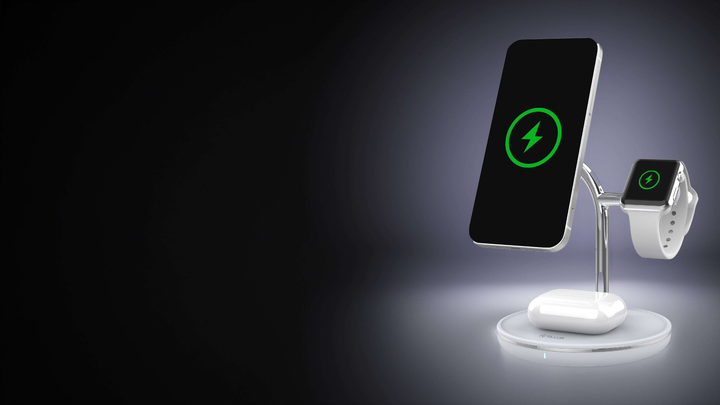
MagSafe Certified, 3-in-1 Charging Solution for Apple Devices
Simplify your charging routine with a single that use MagSafe to charge your iPhone, Apple Watch, and TWS earbuds - all at the same time;
No more hassle of managing multiple chargers and cables;
Certified by Apple for reliable performance and compatibility;

Slide 4
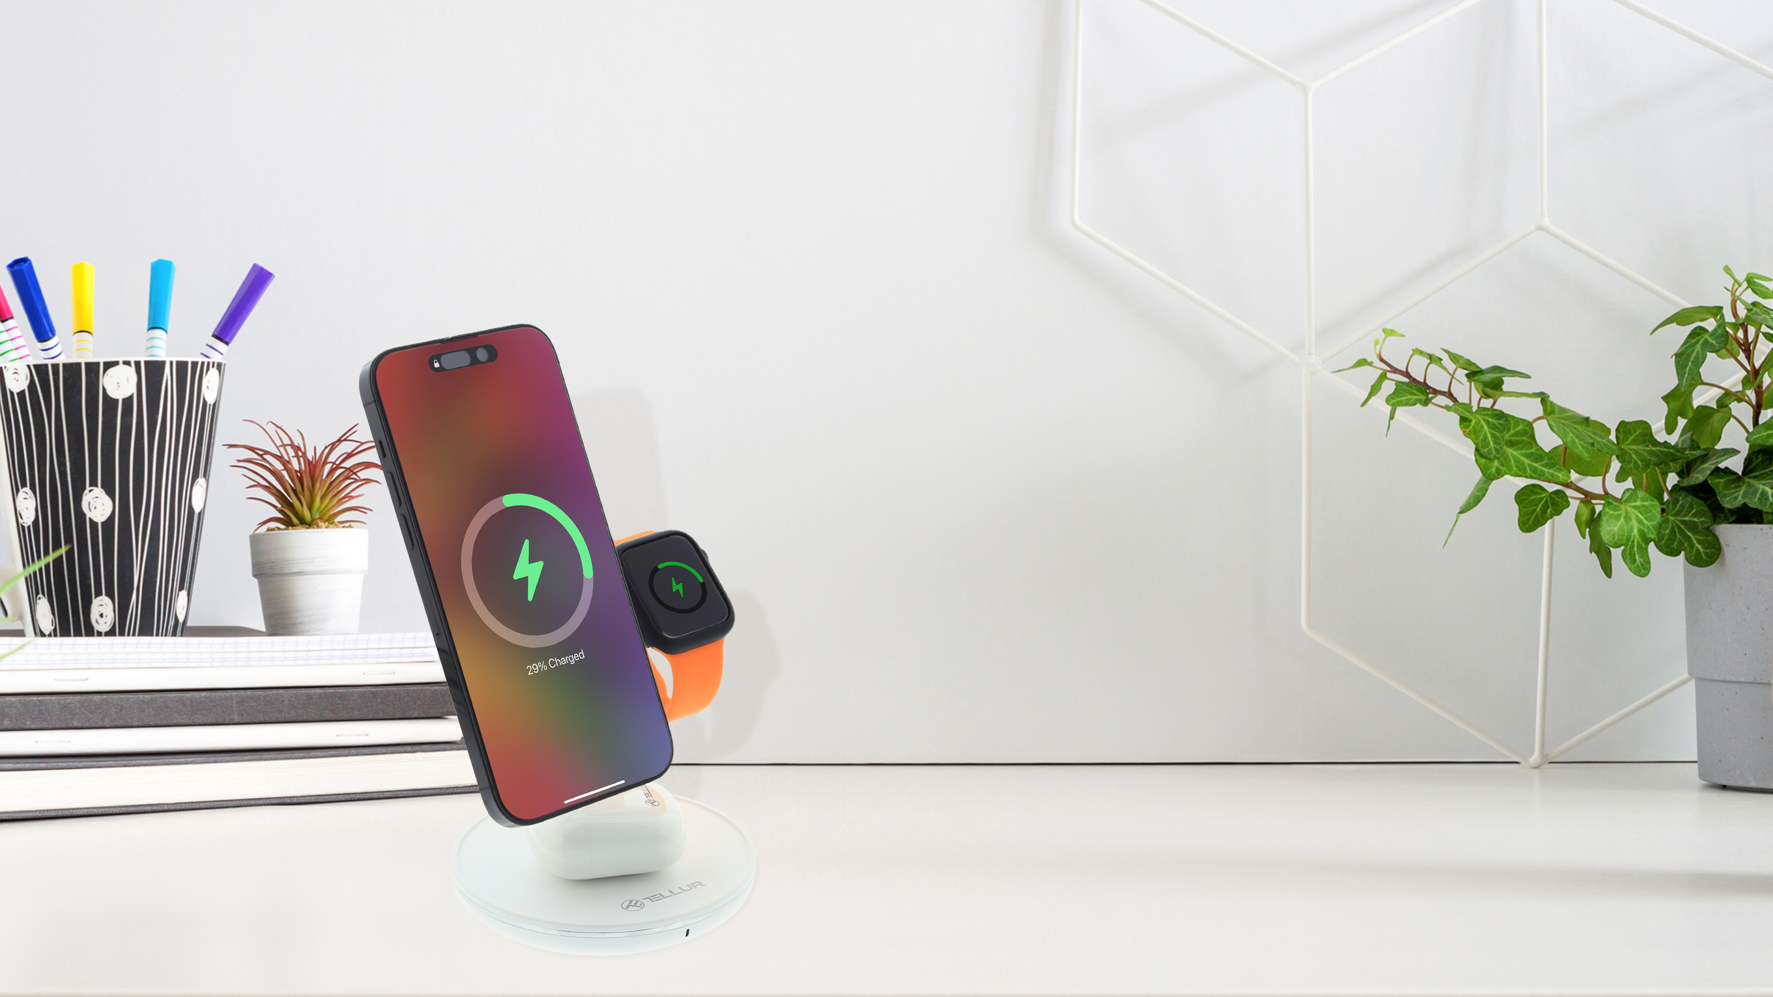
Experience the convenience of MagSafe technology for quick and reliable charging
Supercharge your iPhone with 15W charging for faster power-ups
Keep your Apple Watch powered throughout the day with 2.5W charging
Enjoy uninterrupted music with 5W charging for your TWS earbuds

Slide 5
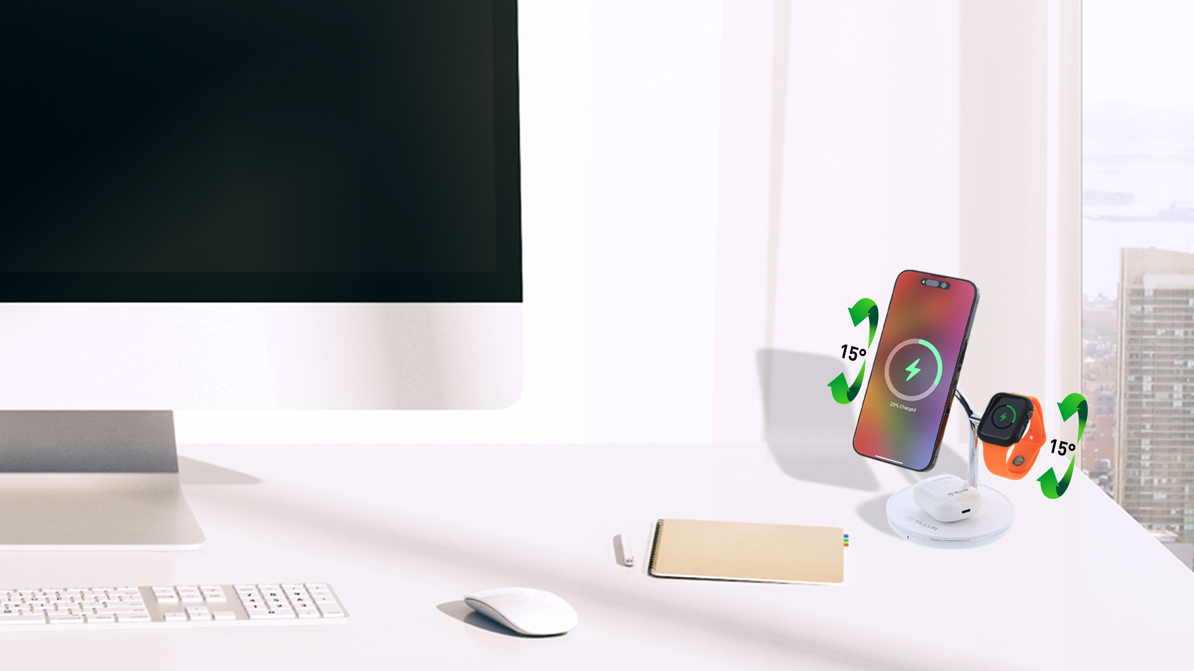
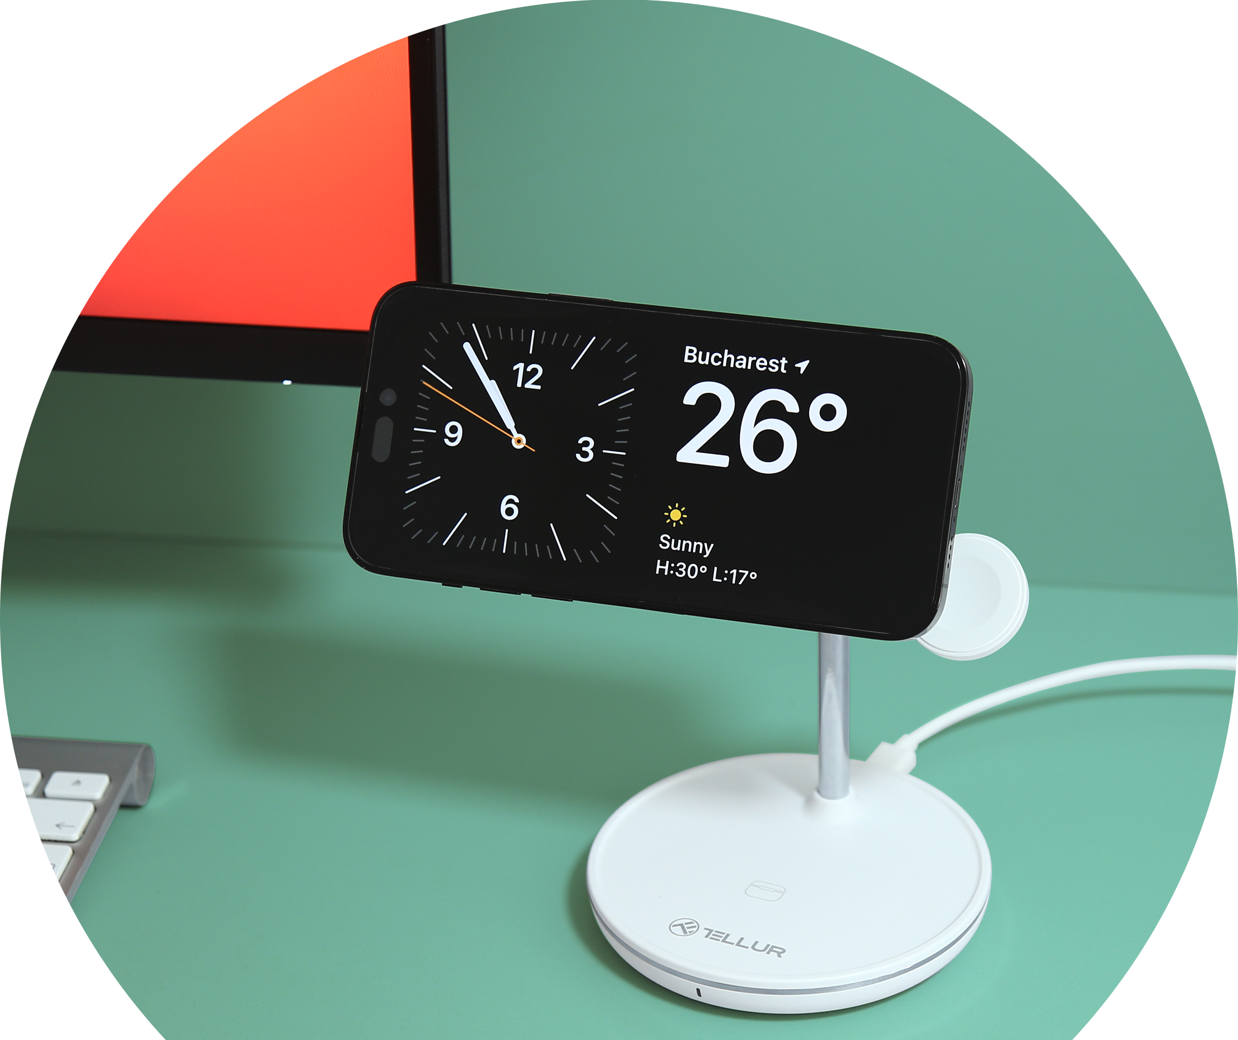
Versatile and adjustable
Charge your iPhone in any orientation - landscape or portrait
Adjustable angle feature allows you to find the perfect viewing angle

Slide 6
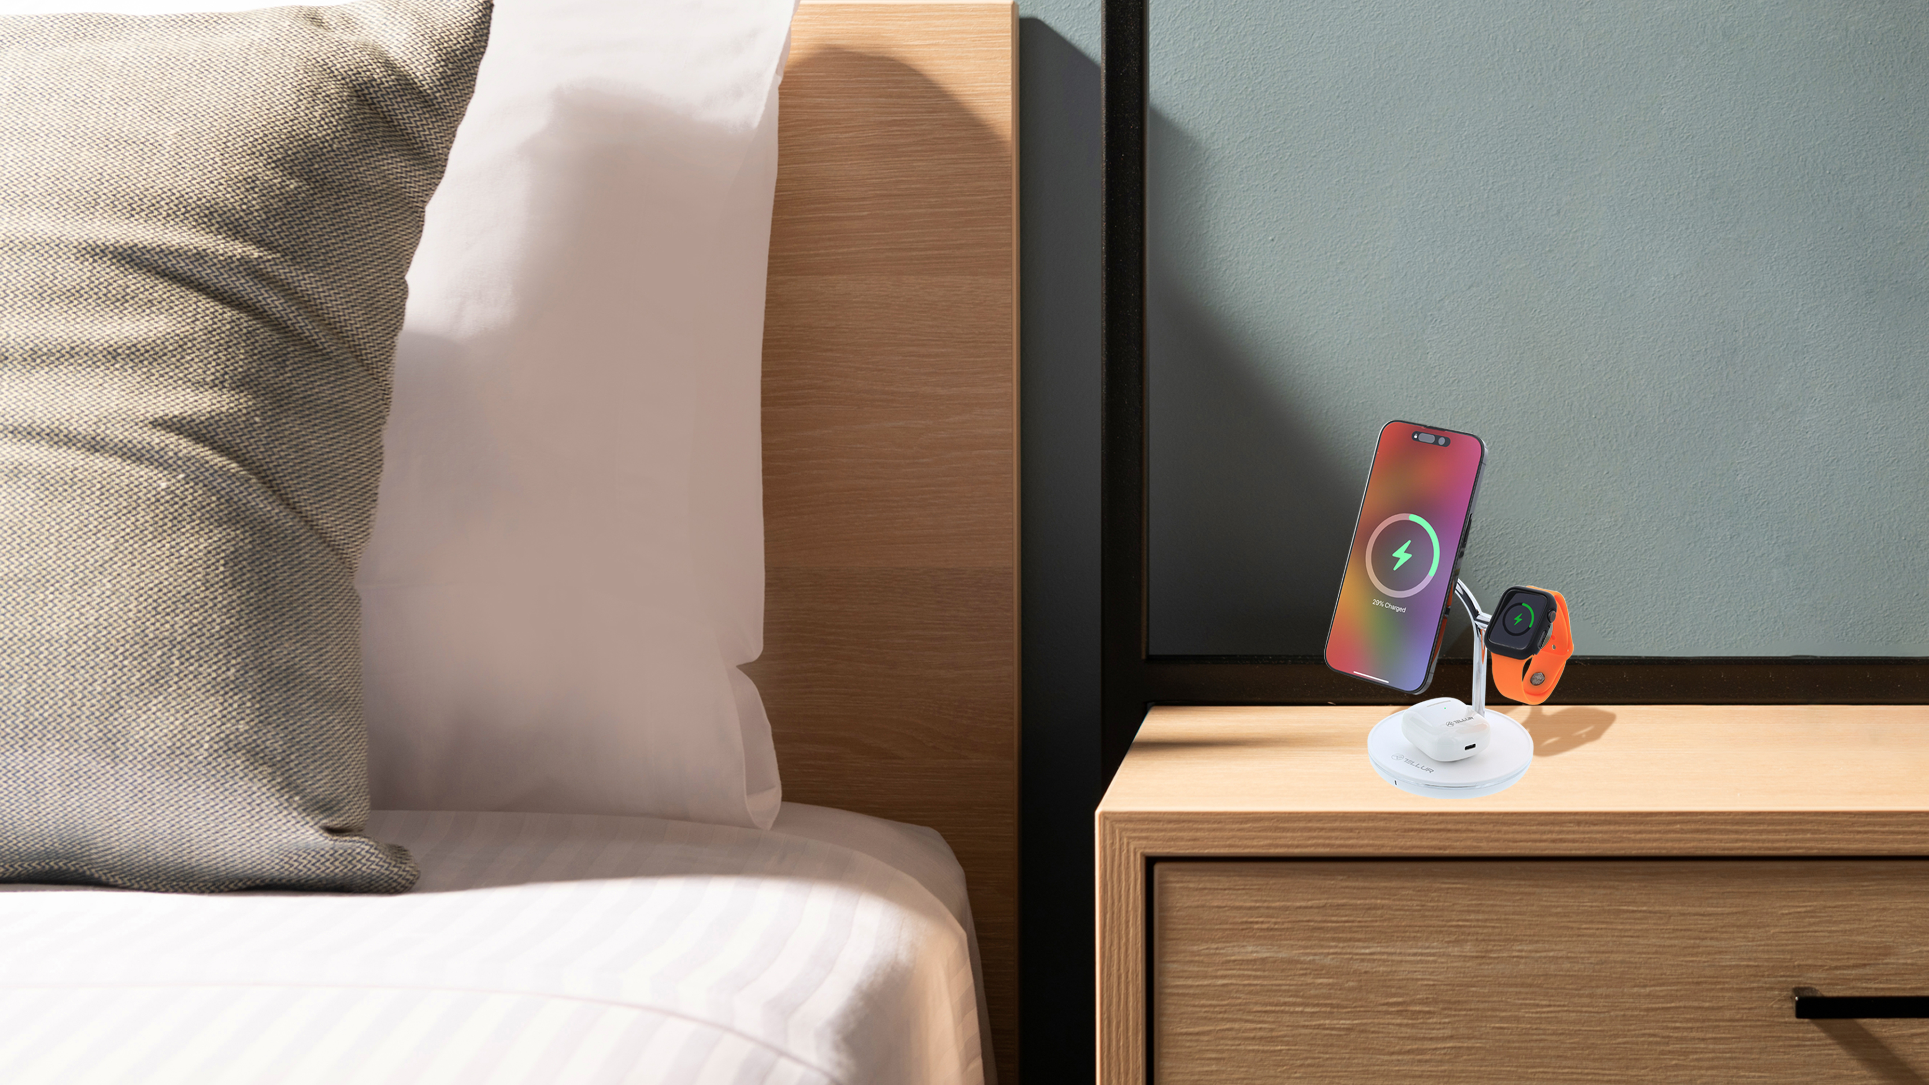
Design that Complements Your Space
Modern and minimalist design that adds a touch of elegance to any environment
Sleek and compact form factor that doesn't clutter your space
Seamlessly integrates into various settings, including office desks, bedside tables, and living spaces
Aesthetically pleasing design that complements your personal style and enhances your overall environment

Slide 7
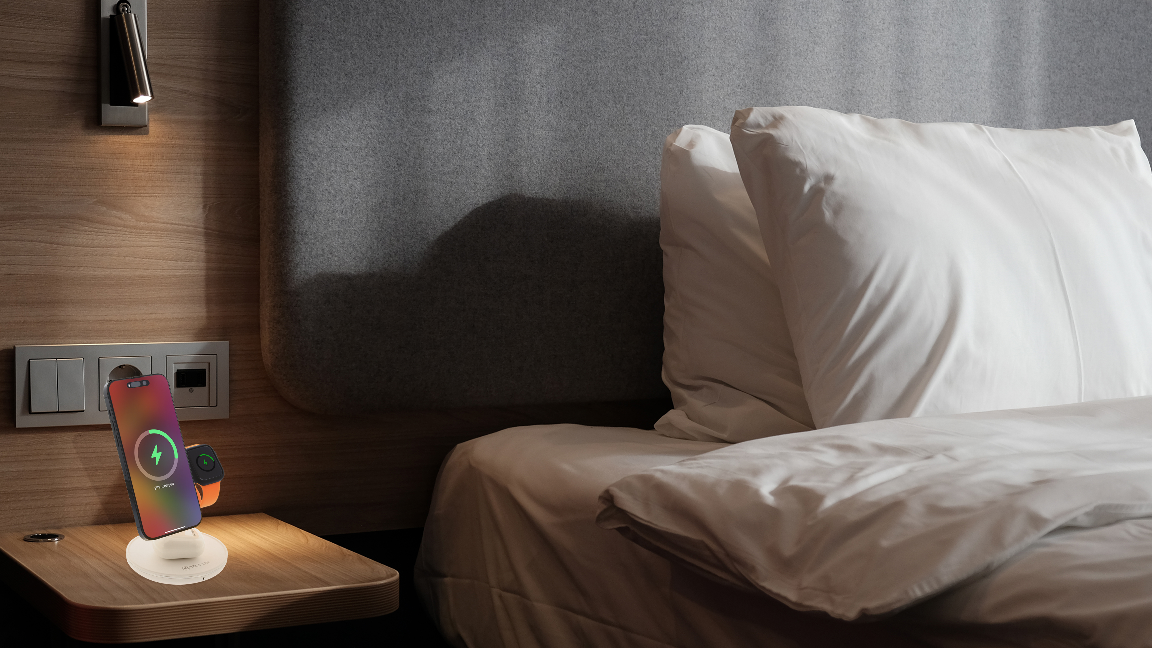
Safety and compatibility
Built-in safety protections: overvoltage, temperature control, and foreign object detection
Compatible with iPhone 12 or newer models, AirPods 2/3/Pro, and Apple Watch 1-8

Slide 8
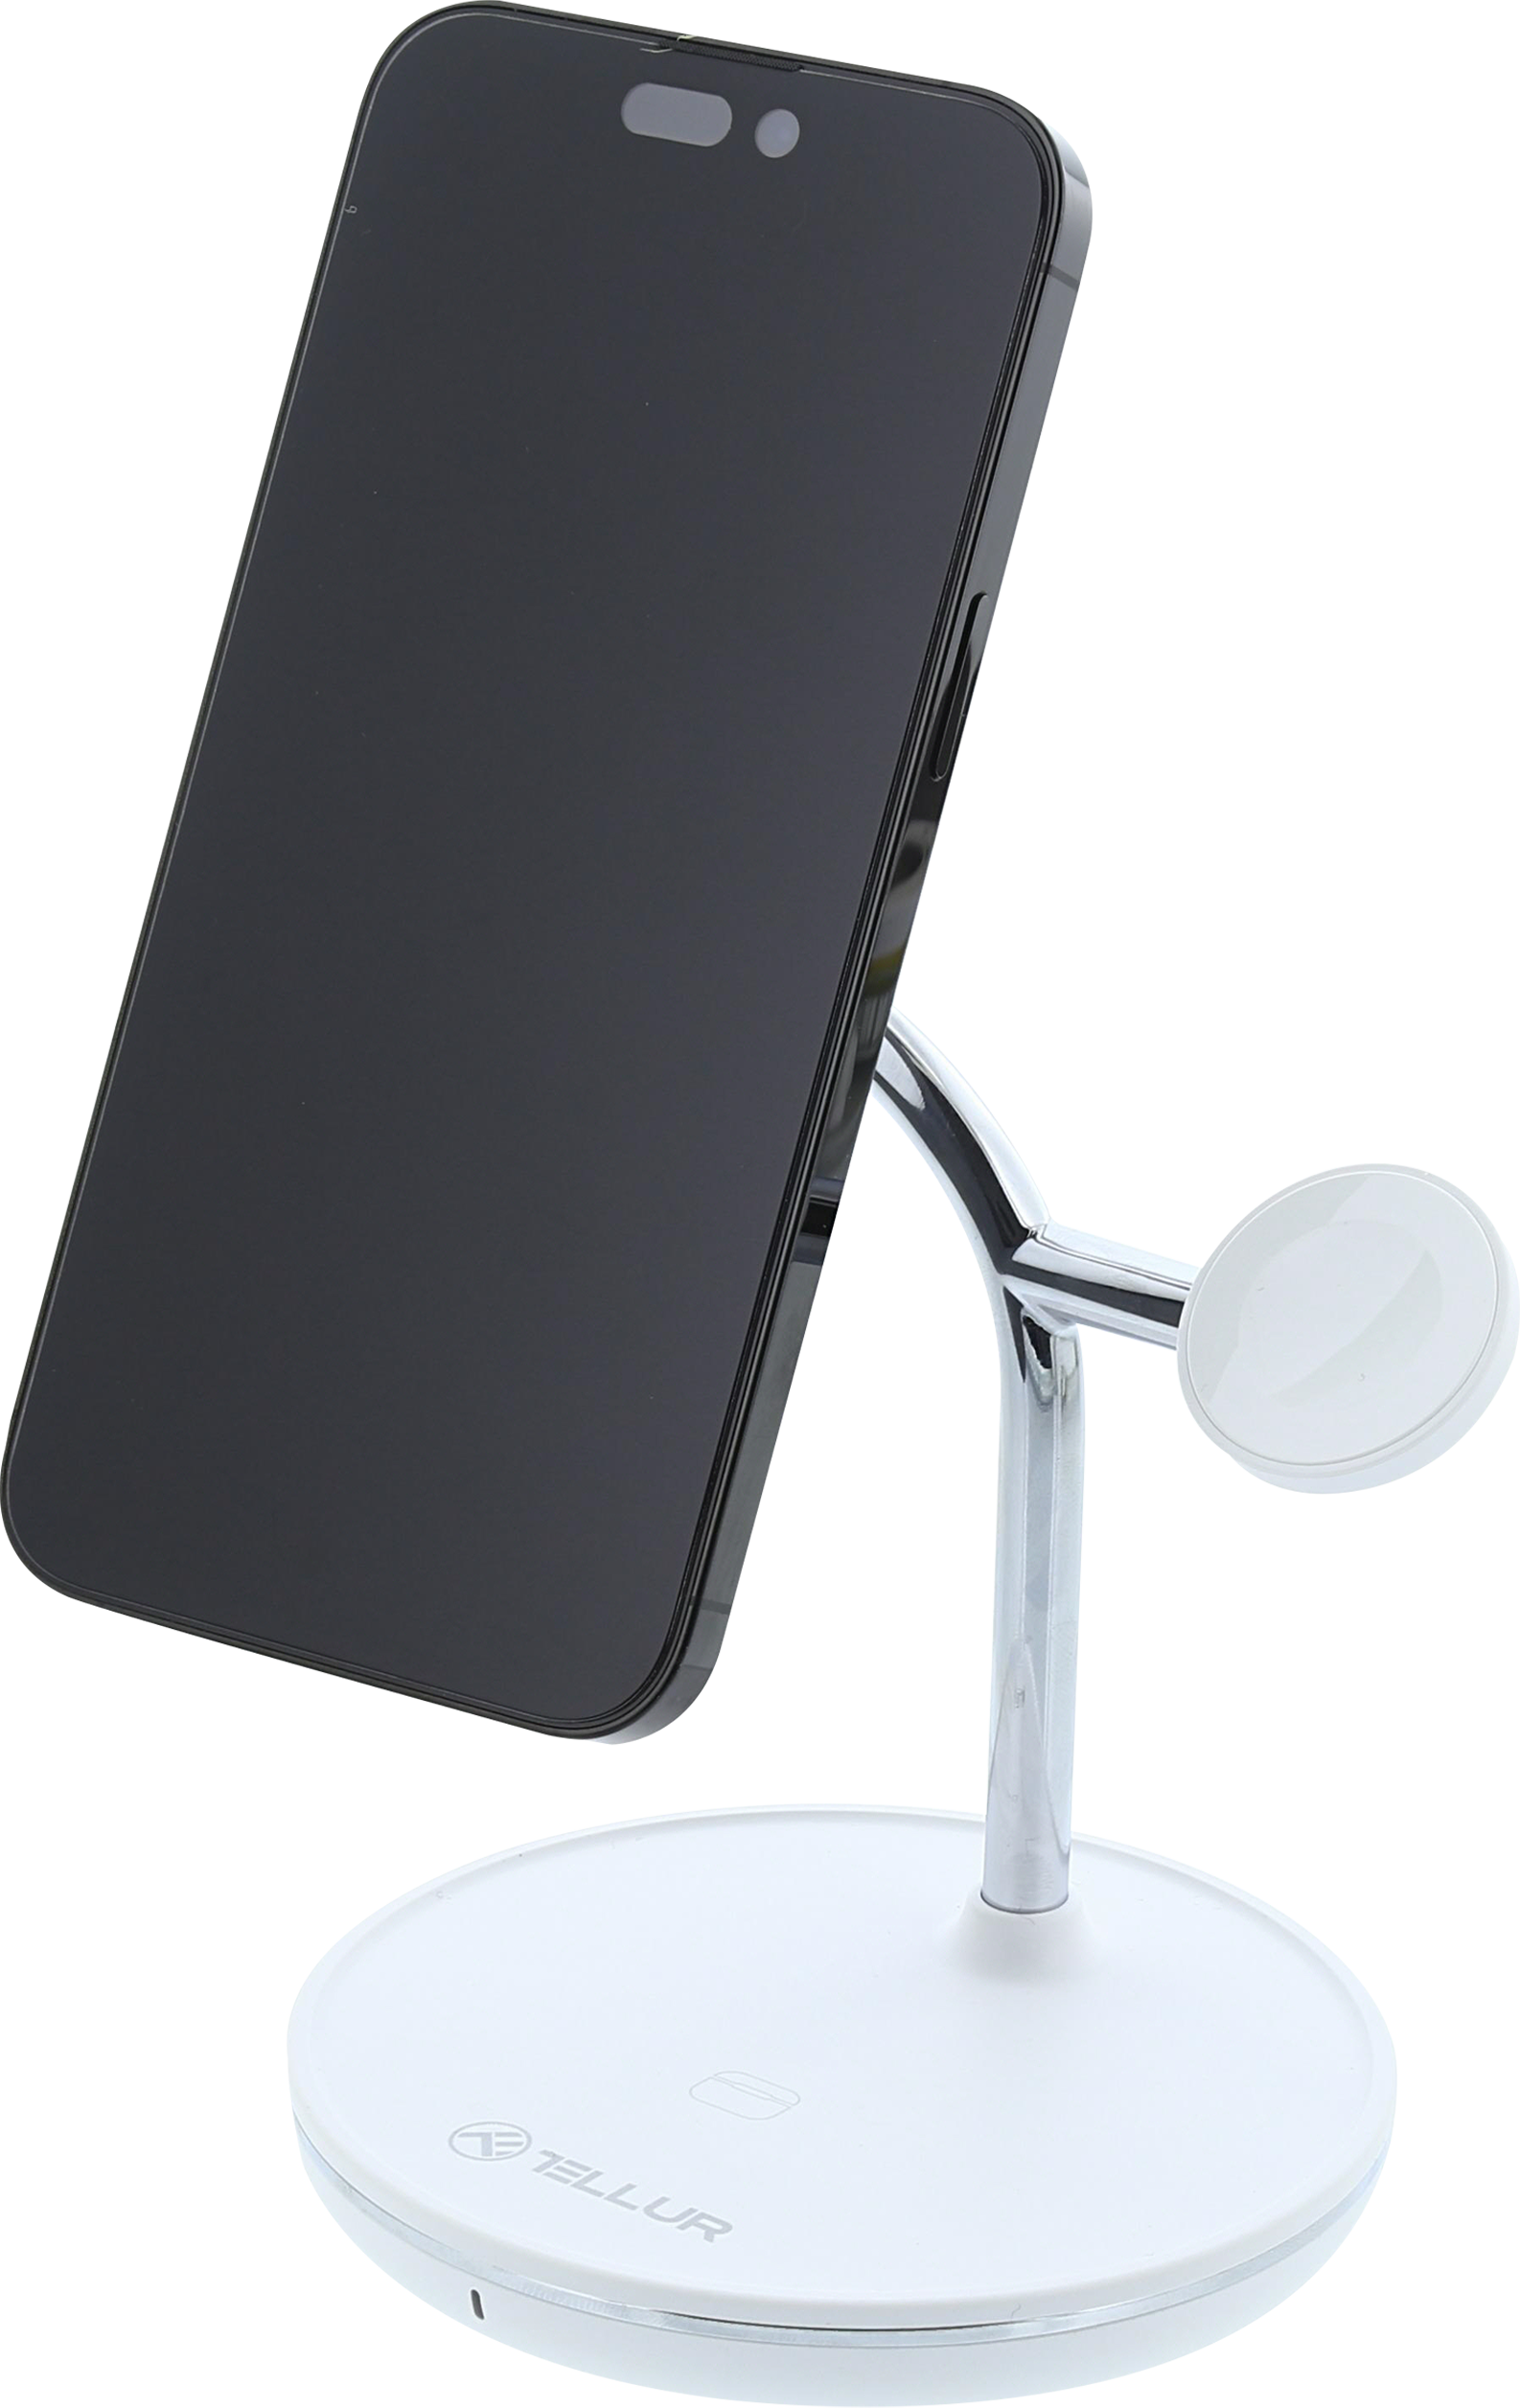
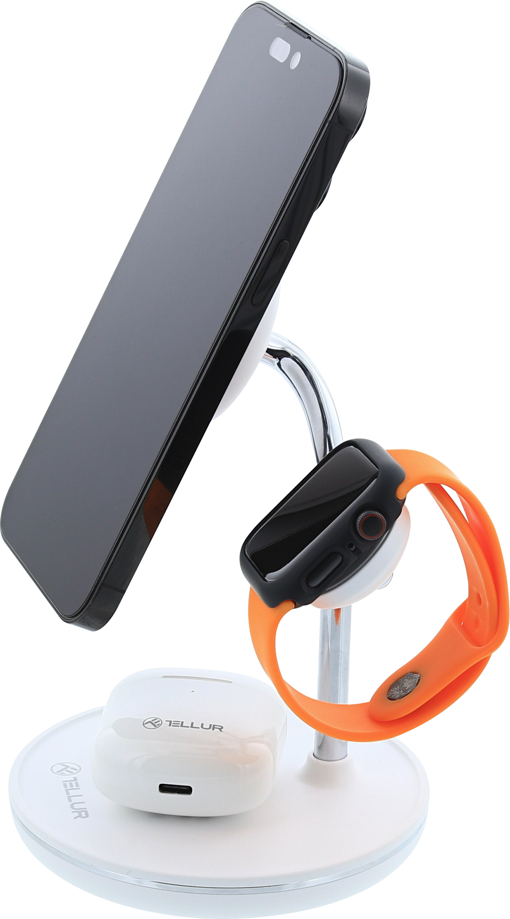
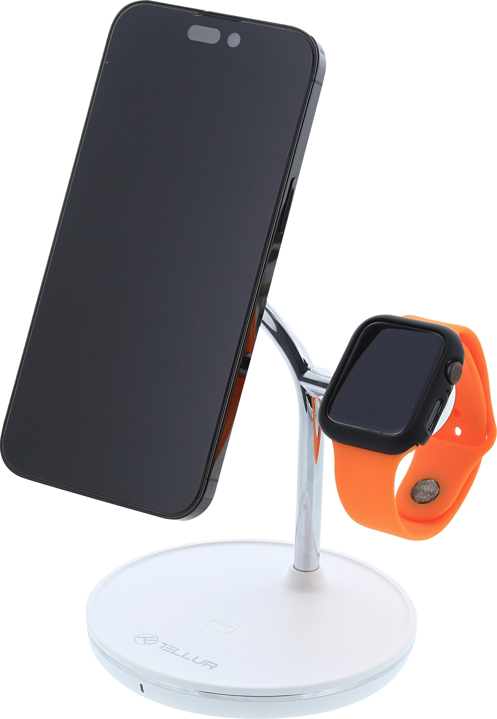
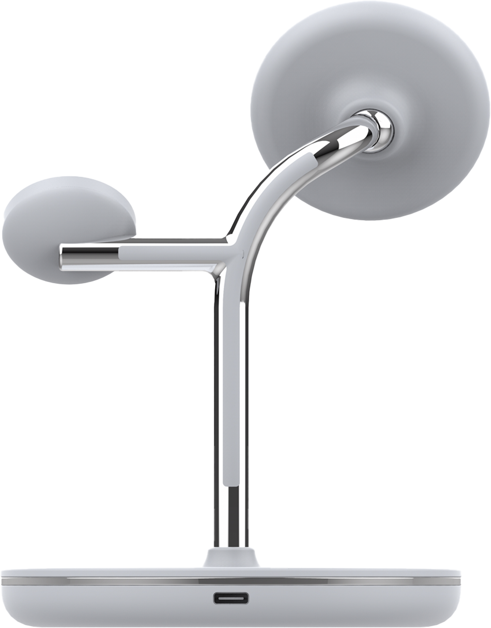
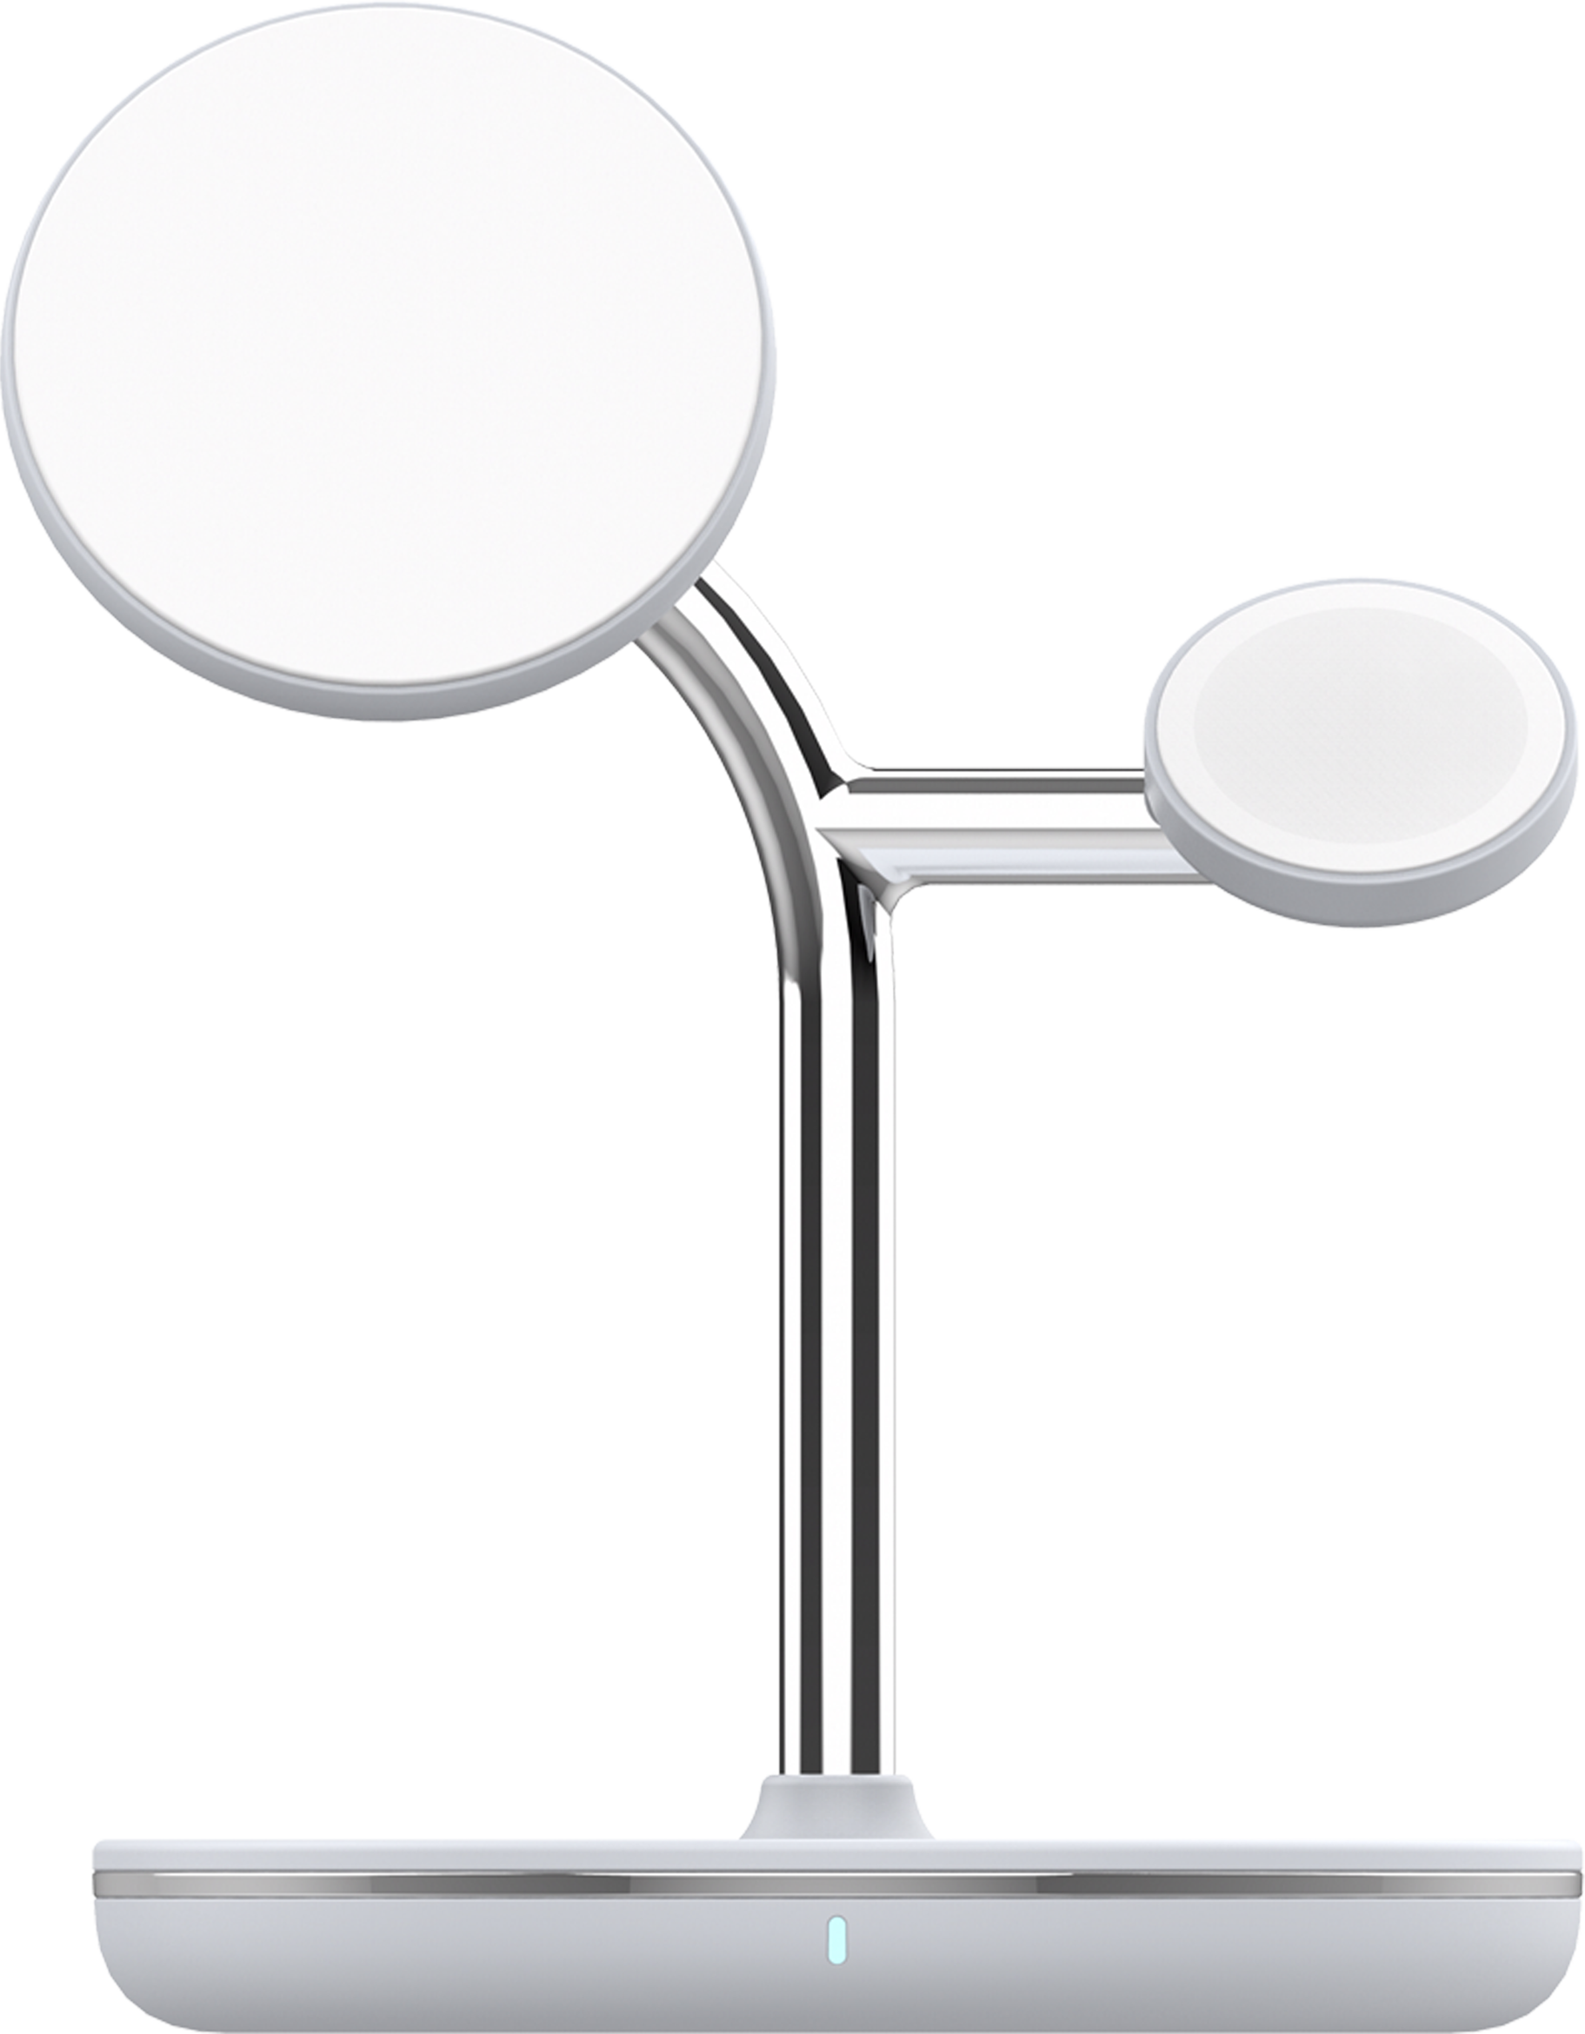
Technical specs
Input: | PD 9V/3 A , 12V/2.5, 15V/2A , 30W Max
Input port: | Type-C
iPhone output: | MagSafe 15W(Max), 10W, 7.5W, 5W
AirPods 2/3/Pro output: | 5W
Apple Watch output: | 2.5W
Total output: | 22.5W (Max)
Cable: | Type-C to Type-C, 3A - 1.8 meters
AC Charger: | PD 30W Type-C
iPhone position: | Landscape or portrait, 15° adjustable angle
Material: | PC + ABS + Metal
Product compatibilities: | MagSafe Fast Charging up to 15W for iPhone 14/ 14 Plus/ 14 Pro/ 14 Pro Max/ iPhone 13 mini/ 13/ 13 Pro/ 13 Pro Max/ iPhone 12 mini/ 12/ 12 Pro/ 12 Pro Max
 | 5W charging for AirPods 2/3/Pro and other TWS earbuds which support wireless charging
 | 2.5W charging for Apple Watch 1/2/3/4/5/6/SE/7/8/Ultra
Safety protections: | Overvoltage protection, temperature control and foreign object detection
Color: | White
Size: | 109 x 159 x 125mm
Weight: | 330g
Package includes: | 1 x 3-in-1 MagSafe wireless desk charger 1 x Type-C to Type-C PD cable 1.8 meters 1 x PD 30W Type-C port EU AC Wall Charger 1 x UK AC Charger Adapter 1 x US AC Charger Adapter
Package dimensions: | 290 x 170 x 180mm
Package weight: | 1430g
Product code: | TLL151391
EAN: | 5949120004640

Slide 9
THANK YOU!
For more products, please visit : https://www.tellur.com

