Slide 2
Innovation in every detail
The revolutionary Graphene technology is now available in a power bank – the GPD100 Graphene Wireless 10000mAh power bank!
This cutting-edge material ensure during recharging and extends its life up to three times.

Slide 3
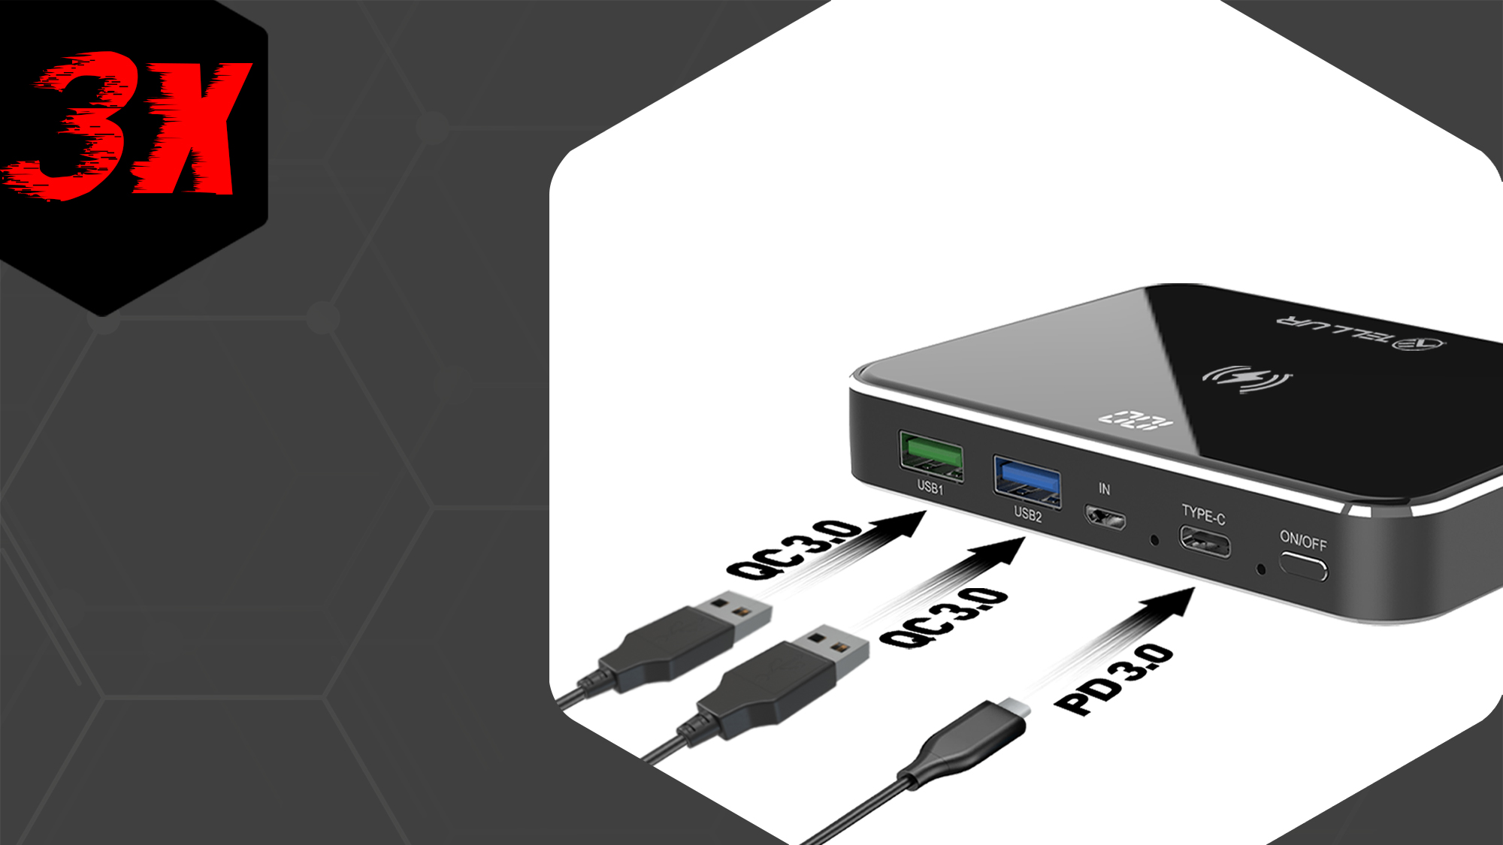
You can charge your gadgets up to 3 times faster than traditional external power banks.

Slide 4
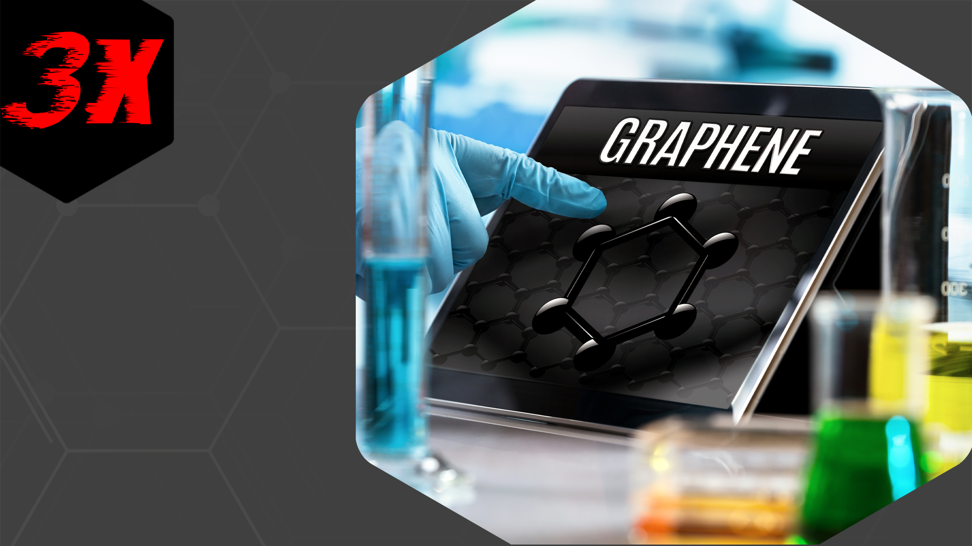
Graphene Technology
Revolutionary Graphene technology ensures the battery remains cool and increase its longevity by three times.

Slide 5
Modern and elegant
The power bank housing is
made of high-quality materials, metal and shiny tempered glass.

Slide 6
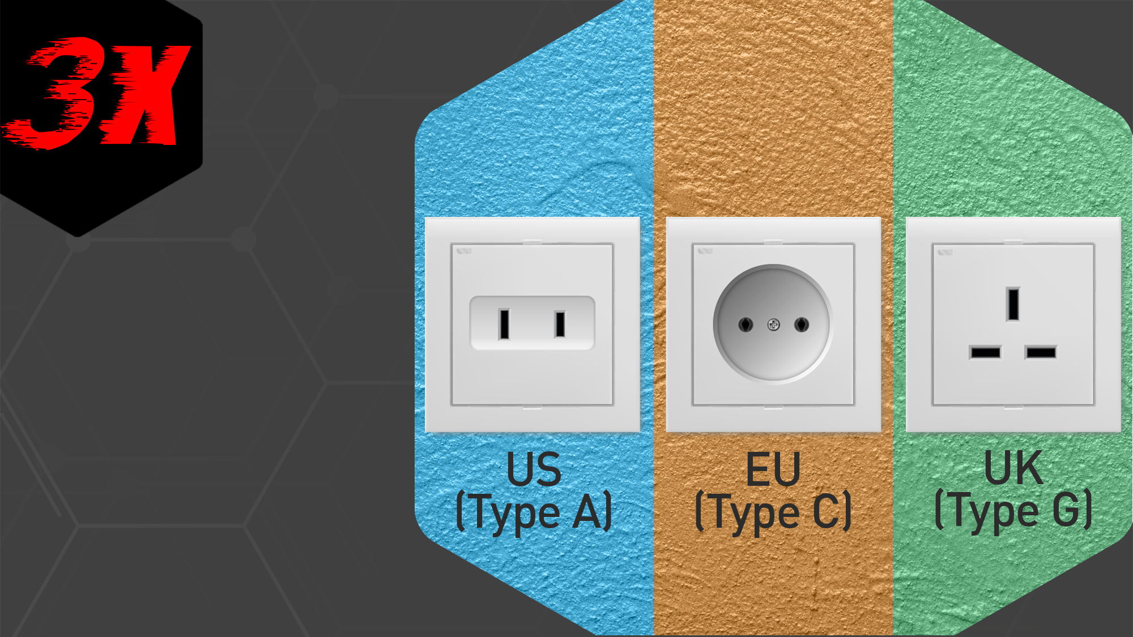
Power adapter
US,EU,UK - Power adapter
compatible with GPD100
Graphene Wireless power bank.

Slide 7
More than one device to recharge?
No problem!

Slide 8
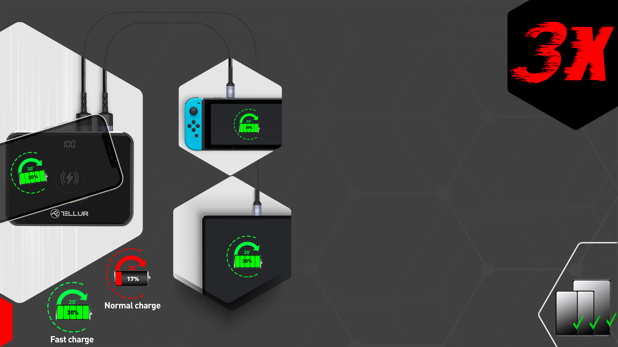
Charge 3 devices
simultaneously
The GPD100 power bank allows you to recharge multiple devices simultaneously via wirelessly, PD Type-C or QC 3.0 ports.
Also, in graphene battery, a multi-stage protection system is implemented for absolutely safe charging that complies with international standards.

Slide 9
Fast recharging
The power bank supports USB-C PD technology and can be charged at a rate of up to 60W. This means the GPD 00 capacity of 1O.OOO mAh can be
fully recharged in Just one hour with the
included 60W wall charger . That
makes recharging this wireless
power bank up to three times
faster than the rest of power
banks

Slide 10
THANK YOU!
For more information, please visit smart.tellur.com.

